Slide 1
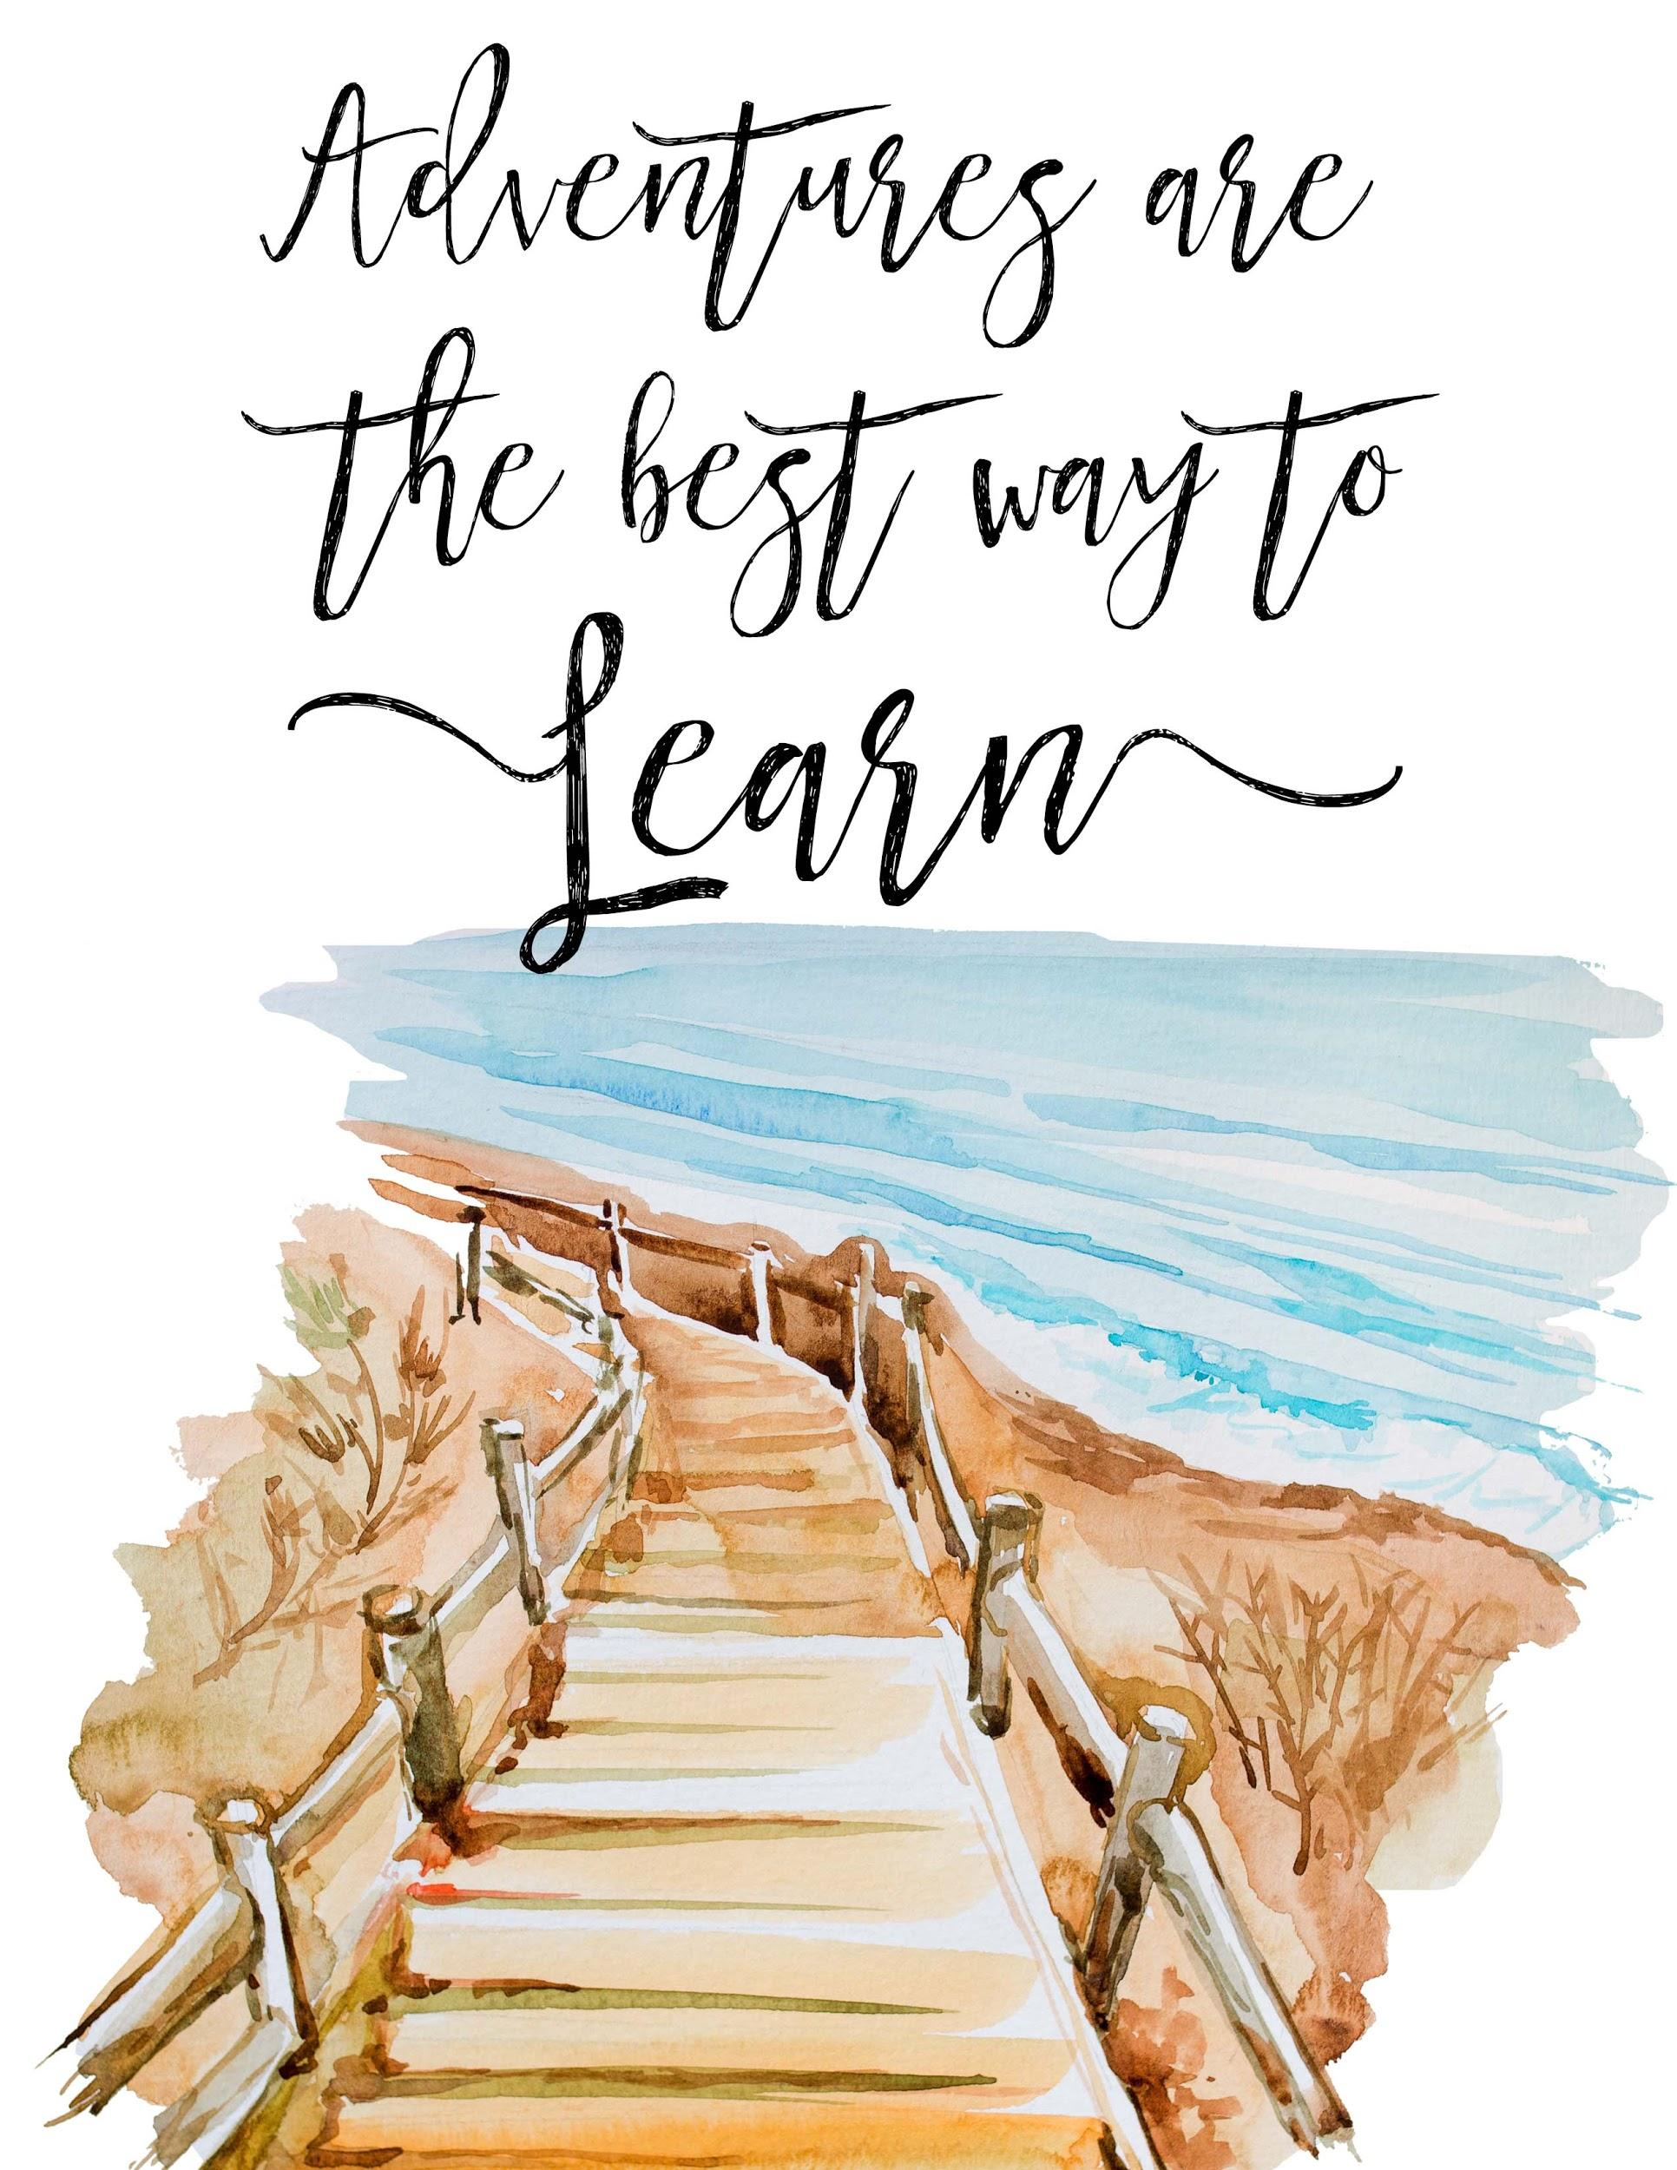
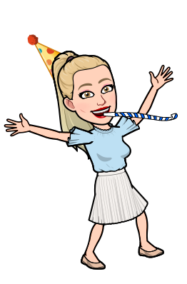
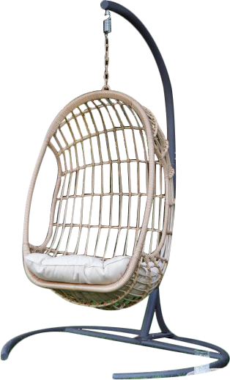
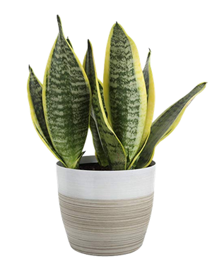
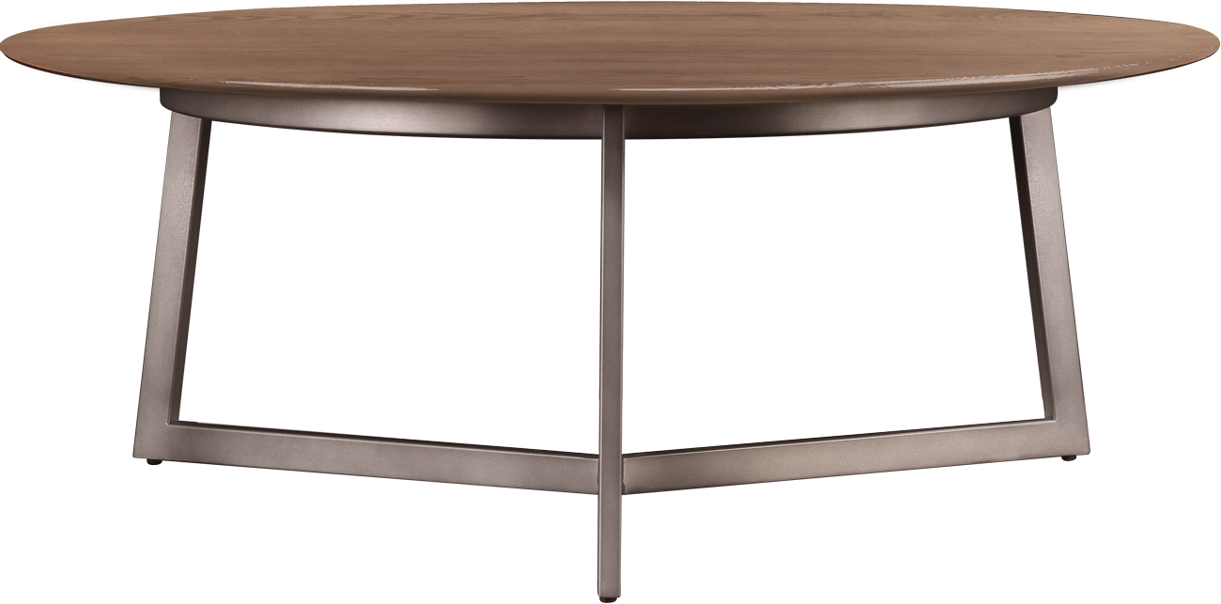
Welcome to 6th Grade!

Slide 2
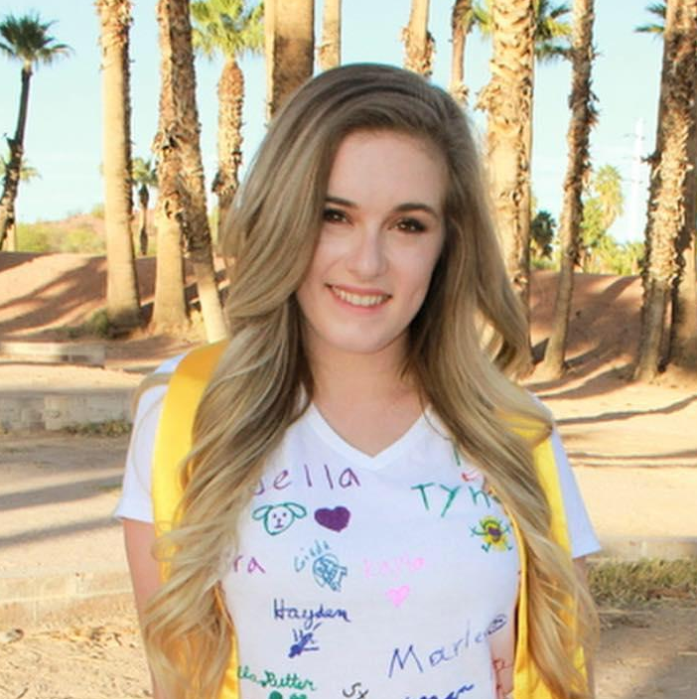
My name is Ms. Luongo and I am going to be your English Teacher this year!

Slide 3
I was born in New York where I lived there until I was 9.
Then, I moved to Plano and went to Brinker Elementary and Renner Middle school!
When I was 13, I moved to Scottsdale, Arizona! I lived there until I was 22!
Then, I moved to Connecticut and was a Co-Teacher for a 2nd grade and then 3rd grade class!

Slide 5
I went to Arizona State University
and I am a HUGE ASU Sun Devils Fan!

Slide 6
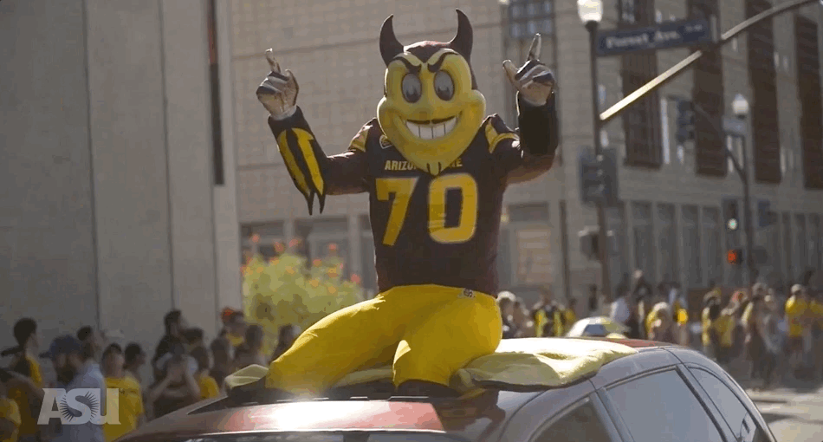

Slide 7
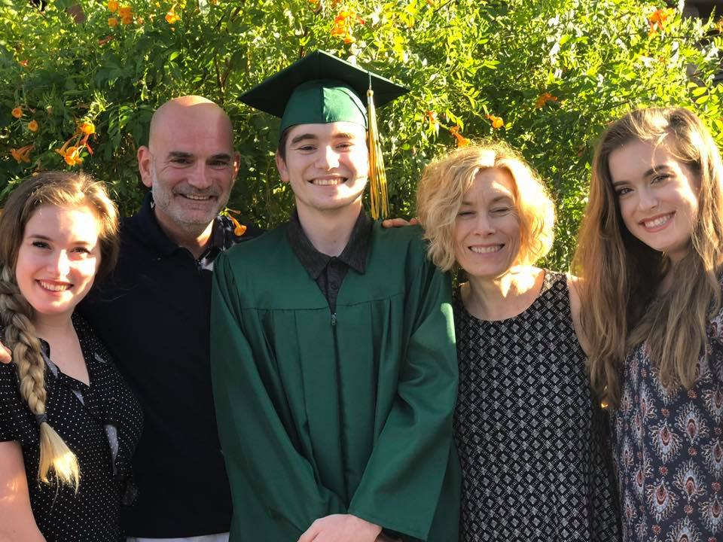
In the picture is me, my dad, my younger brother Joey, my mom, and my IDENTICAL TWIN Alison!
They all still live in Arizona!

Slide 8
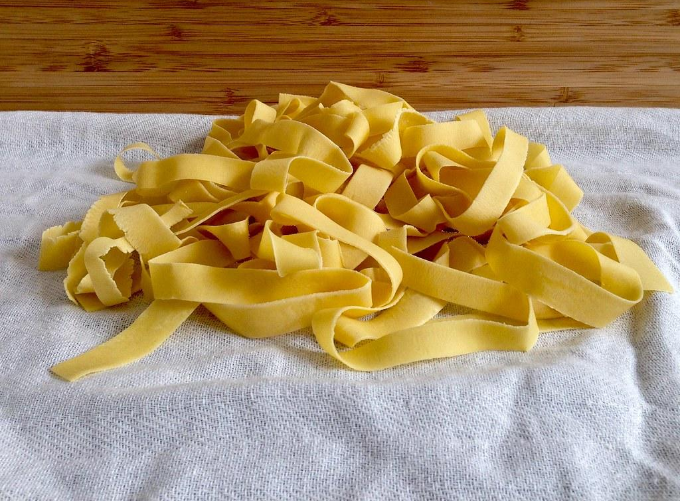
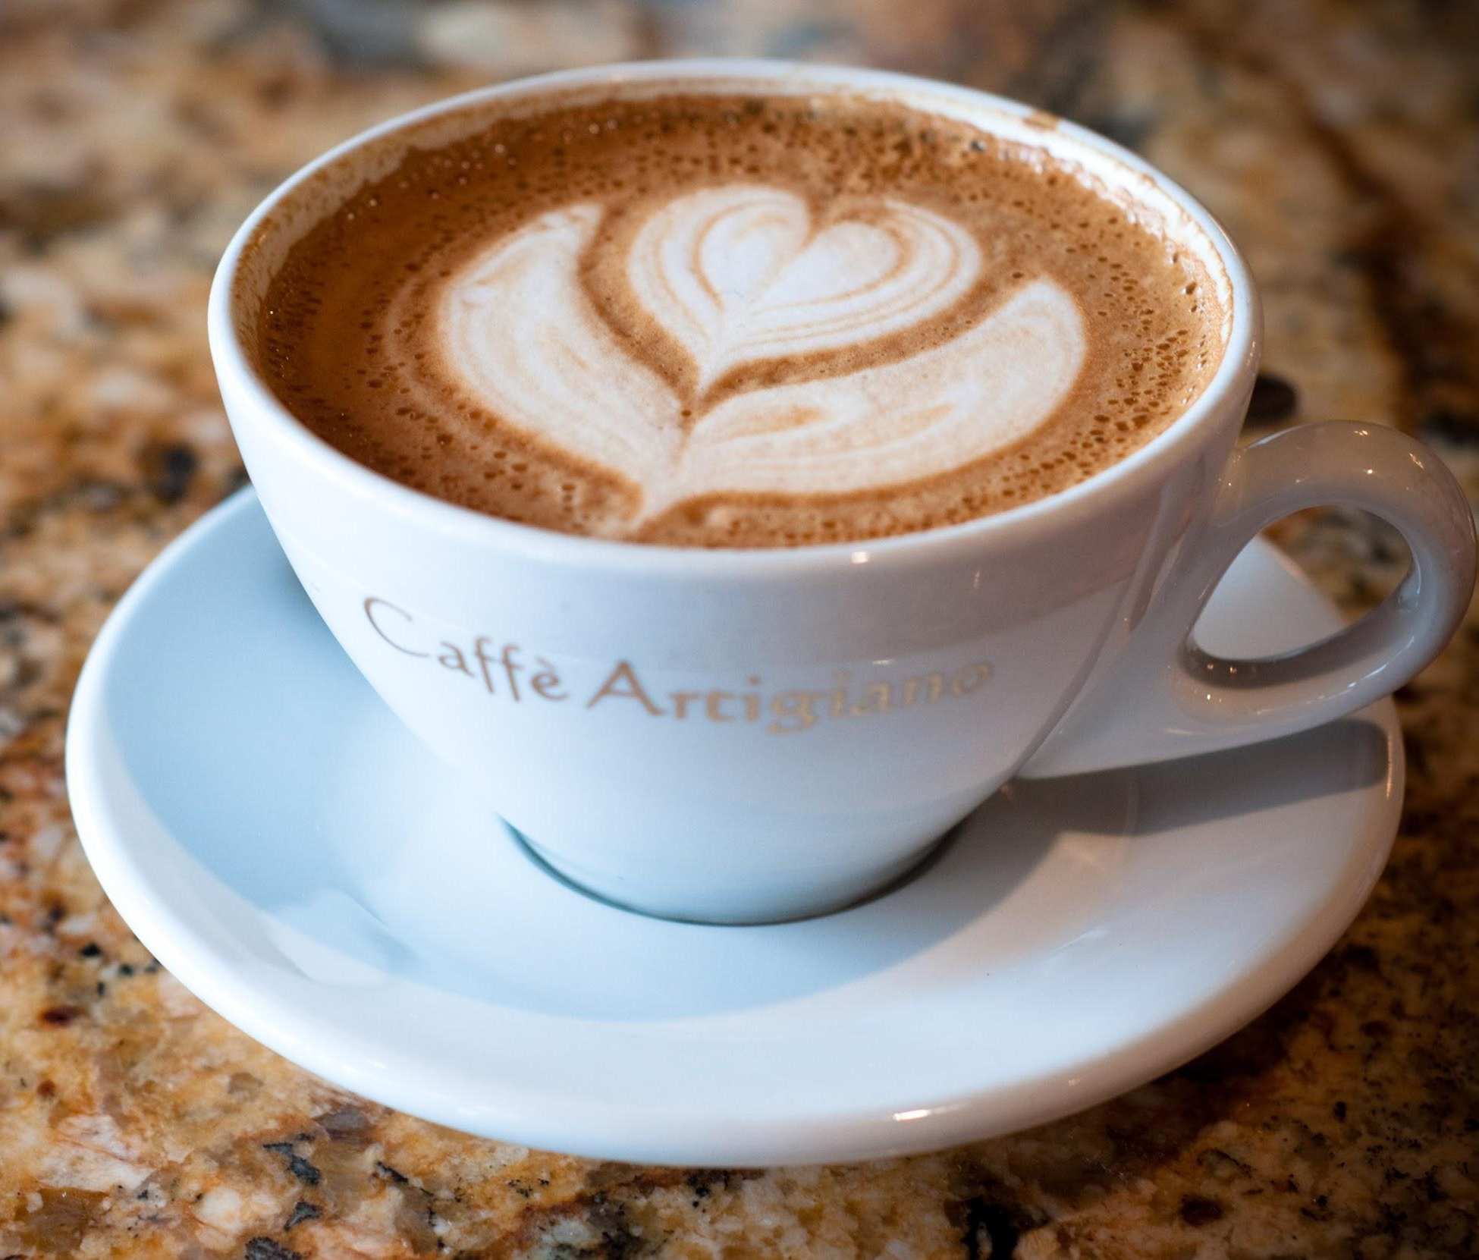
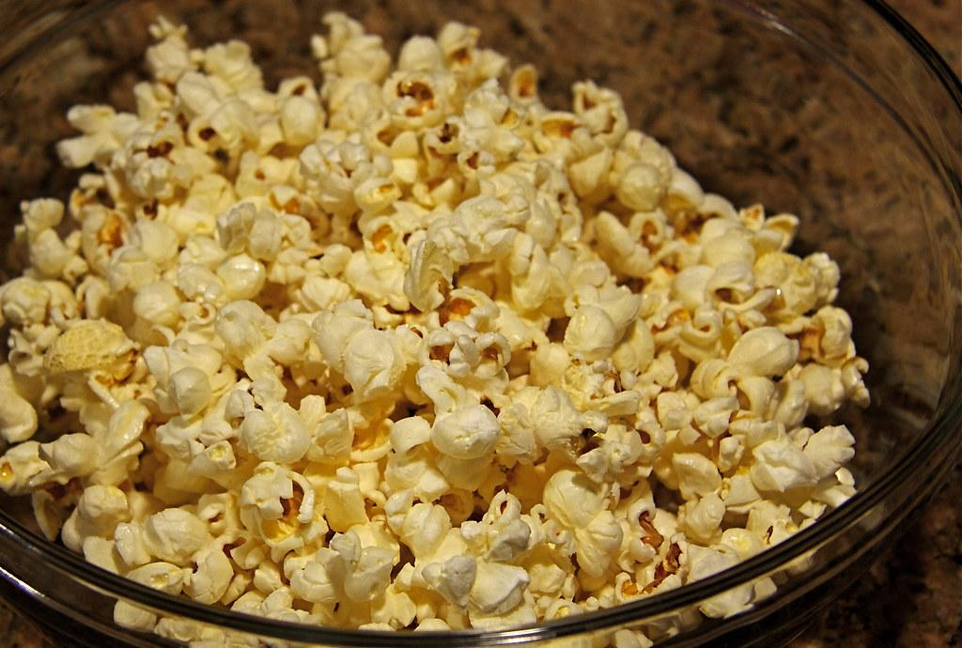
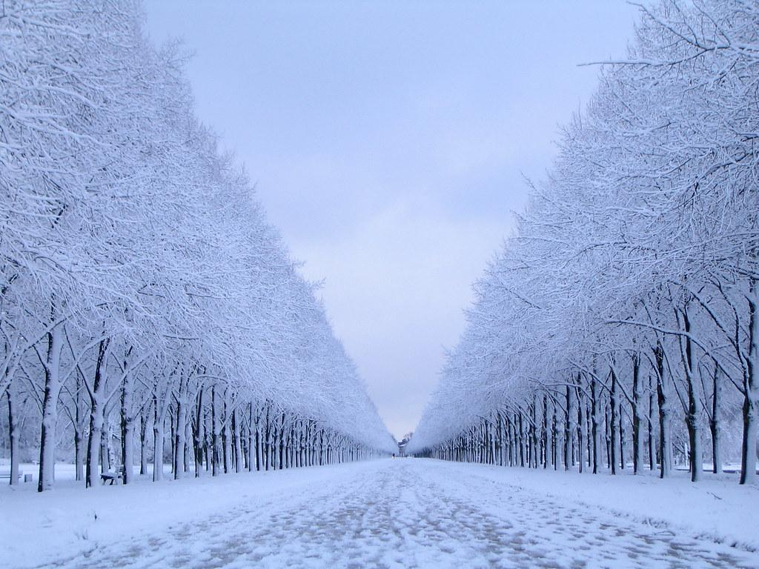
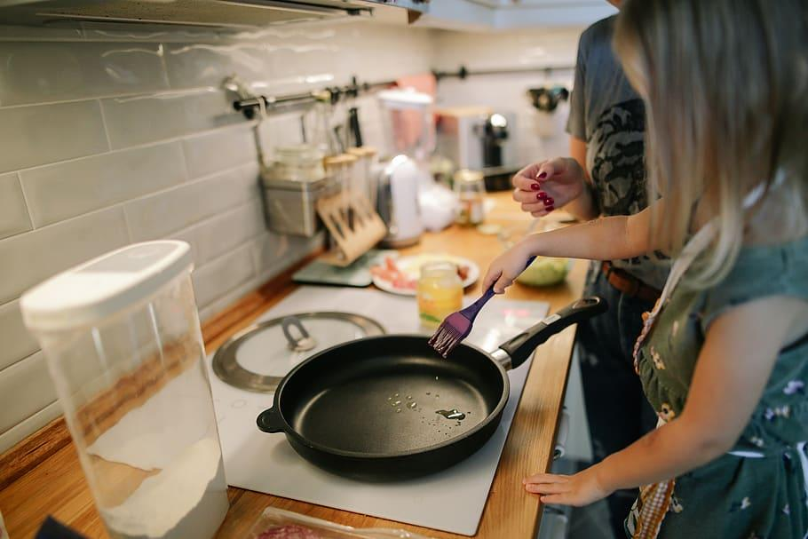
My Favorites:
My favorite food is PASTA!
My favorite drink is coffee!
My favorite snack is popcorn!
My favorite season is winter!
My favorite hobby is cooking!
My favorite after school activity is Netflix!

Slide 9
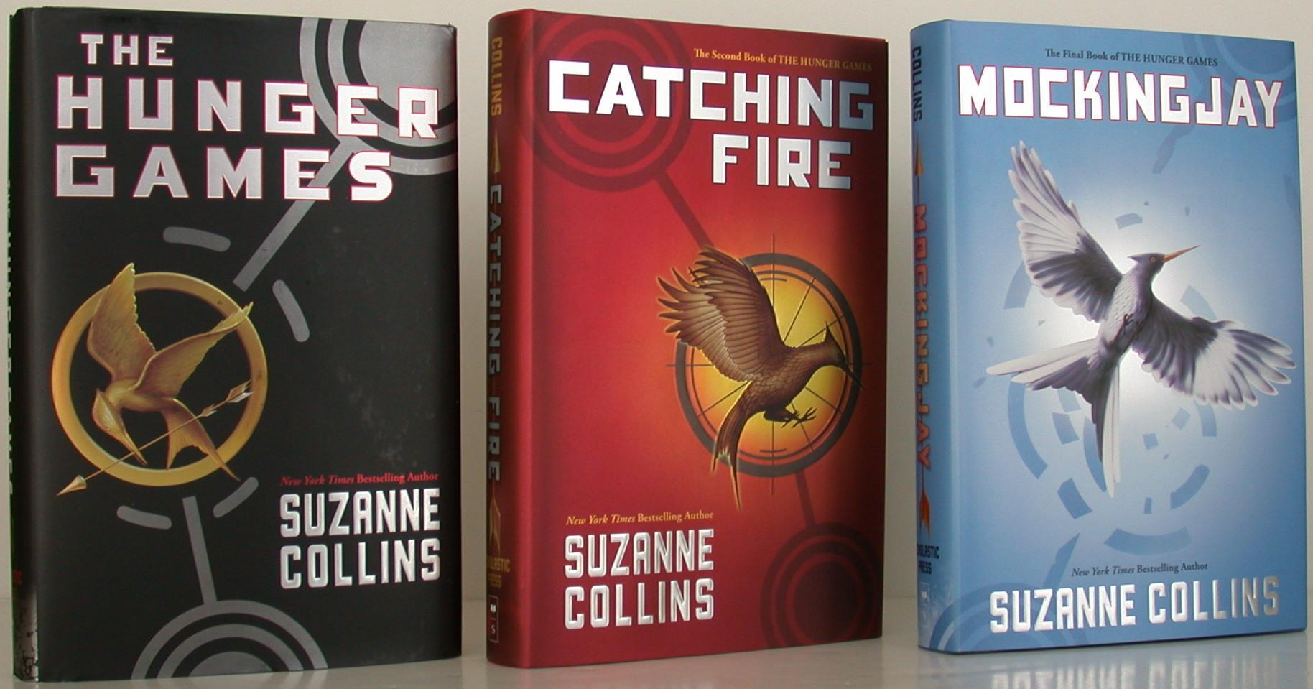
My Favorite Books:

Slide 10
What to expect from me as your teacher...
We will start every day with some sort of mindfulness or warm-up activity to get your mind ready to learn! We will also learn about different ways you can use mindfulness in your everyday life!
I LOVE “dad jokes” and I am a very goofy teacher! I love to be silly and I want to incorporate as many jokes, games, and fun into every lesson! If you have a good joke, share it with us (specific time will be given so no need to should it out).

Slide 11
That is some quick information about me!
I am so excited to get to know you all!
It’s going to be a
great year!

